Slide 1
6th Grade Essentials, Extensions & Interventions
Unit 3: Proportional Reasoning
Resources for the
6th grade Unit 3 training
SPED Specialist Presentation
6th Grade MATH Language Demands Design Day

Slide 2
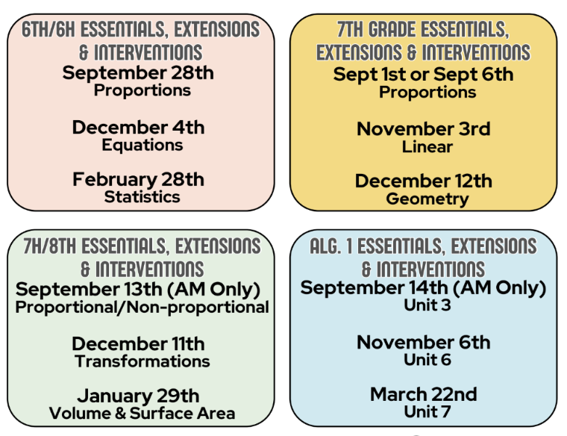
Future Learning
Secondary SPED Specialists:
Victoria Trevino - vtrevi3@neisd.net
Tracy Hechler - thechl@neisd.net
GT Specialist:
Lisa Watson lwatso5@neisd.net
Secondary EB Specialist:
Veronica Duffy vduffy@neisd.net
12/4 @ 210 RAMEC
2/28 @ NEPD Training Room
Secondary Math Specialist:
Mary Cherry - mcherr1@neisd.net

Slide 3
We love feedback.
Please share it with us.
http://bit.ly/MathFeedback_2324

Slide 4
From: https://www.openmiddle.com/
What did you learn from this attempt?
How will your strategy change on your next attempt?

Slide 5
Introduce yourself
What has been the
of your year so far?
highlight

Slide 6
Why’d We Do That?
“When people experience positive emotions, their thinking tends to become more creative, inclusive, flexible, and integrative”
Southwick & Carney, Resilience;Mastering Life's Greatest Challenges

Slide 8
Norms
Engage as a curious collaborator and learner.
Honor diverse perspectives and voices.
Honor the learning that others are doing.
Be present in the moment to participate fully.
Notes:
Why do we need norms?
Because we all learn differently! This is your chance to share your learning needs.
Because we are human! We aren’t always on our best behavior and norms remind us we are in a group of learners
Because we don’t want to waste our time! We have so much to learn in one day, every minute counts!

Slide 9
Learning Intention
Success Criteria
I am learning about research-based strategies that meet the needs of all learners.
I know I am learning when…
I can use the District End of Unit Assessment to compare expectations for learning.
I can describe scaffolding and deepening strategies.
I can plan a direct teach lesson using NASOT elements.
I can use the Language Lens to design and implement linguistic accommodations for my Emergent bilingual students.
I can select an extension and an intervention strategy to implement in my classroom.

Slide 10
Agenda
Time | What | Why
25 min | Opening | To understand what we’ll do today and begin building community.
60 min | District End Of Unit Assessment | To preview the unit test and discuss student thinking. To describe instructional implications based on the unit outcomes.
15 min | Break
75 min | Instructional Model | To experience a direct teach lesson that can be used in this unit and to highlight the value of the CRA model.
11:30-12:30 | Lunch
60 | 60 min | GT(12:30-1:30)/SPED(12:30-1)/ EBs (1-1:30)breakouts | Nature and needs & Sped supports
30 min | Check In and Reflection | To revisit the learning from the morning and reflect on the instructional model.
60 min | Intervention & Extension | To engage in an intervention and extension lesson that can be used in this unit.
10 min | Break
15 min | Application | To apply the day’s learning to other chunks of this unit.
15 min | Closing & Goal Setting | To reflect on today’s learning and set a personal goal.
Notes:
Set an Intention and share with your shoulder partner. Intentions can be “I want to be fully present.” “I want to take risk.” “I want to walk away with one new idea.” “I want to set a goal to use at least one idea from today’s training.”

Slide 11
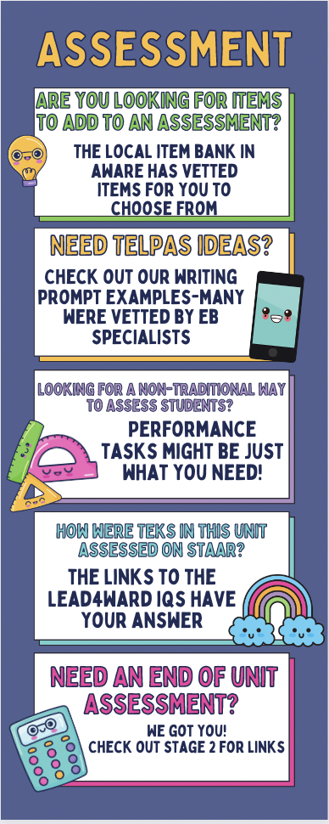
District End of Unit Assessment
Let’s take a closer look.

Slide 12
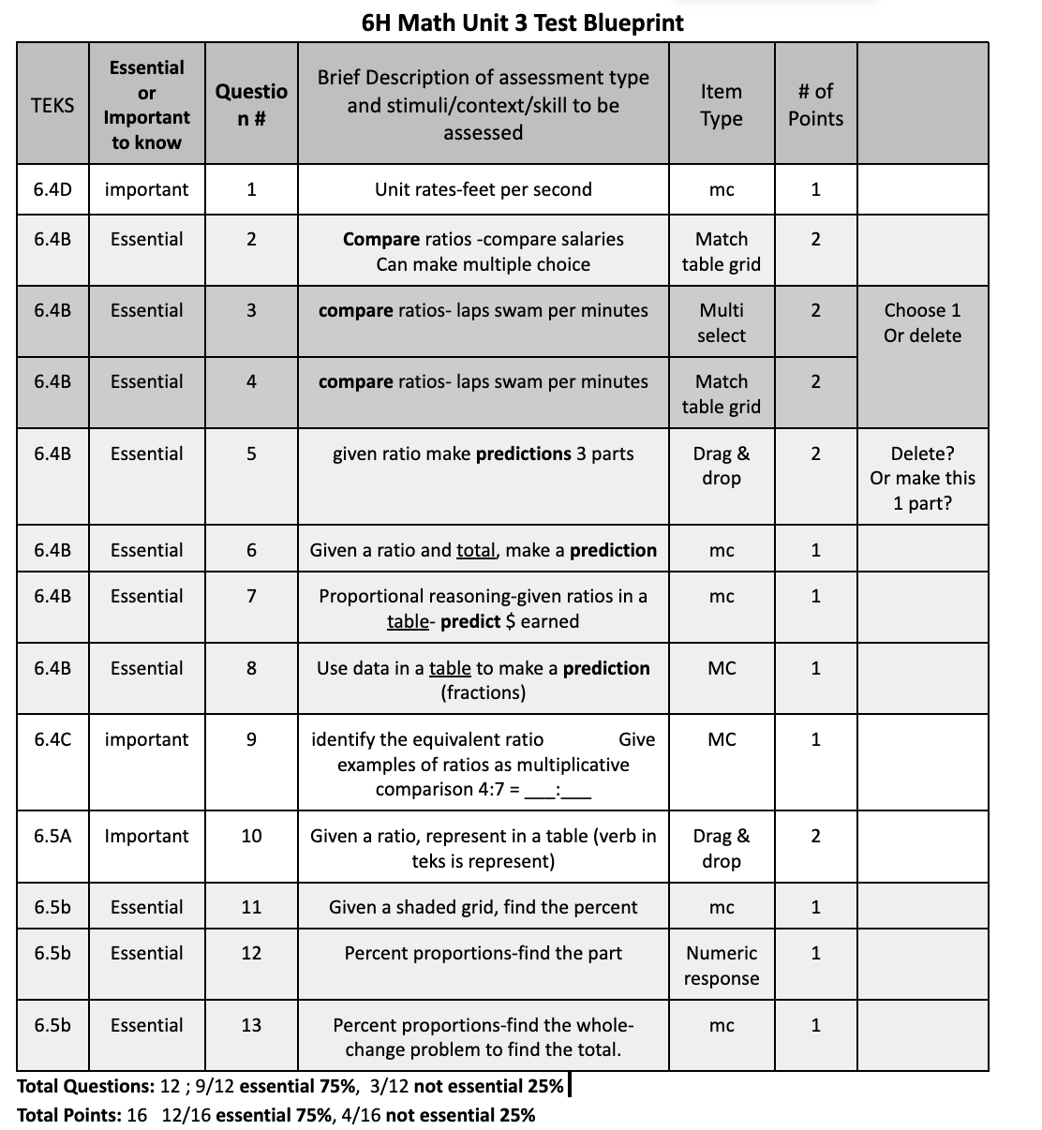
Unit 3 blueprint
6.4B Historically
Predictions- 2023, 2023(w/ total), 2021, 2019, 2019 (w/total), 2018, 2017, 2016, 2016 ( w/ total)
(predictions tested 9 times)
“Total” is part of the solution process- 3 times
Data was in a table 2023, 2021, 2021, 2018, 2016,
-5 times
Comparisons: 2022, 2022, 2021, 2017, (4 total quest.)
Notes:
Created before the assessment based on unpacking the standards.
What do you notice? Wonder?
What question arrangements are not here?
My idea about the test- make #5 a 1 point question and make

Slide 13
District End of Unit Assessment
In the preview mode, take the DEUA.
Before you begin:
Let’s look at the Content Clarifiers
If you have ear buds, please use them so you can easily listen to the Text to Speech
(It has not been corrected on every question)
Notes:
Give teachers paper, ask them to fold it, walk around and model active monitoring
-clarify words in class that are clarified on the assessment, or similar things.
What might you need to do to set students up for success on this online assessment?
Cambium Testing Site used for STAAR: https://login6.cambiumtds.com/student_core/V29/Pages/LoginShell.aspx?c=Texas_PT&a=Student

Slide 14
District End of Unit Assessment
In the preview mode, take the DEUA.
As you work through the test:
Show your thinking in the same way you would expect students to show their thinking.
View the embedded content clarifiers and consider how they can be utilized during instruction.
Think about any implications online testing has on your instruction.
Notes:
Give teachers paper, ask them to fold it, walk around and model active monitoring
-clarify words in class that are clarified on the assessment, or similar things.
What might you need to do to set students up for success on this online assessment?
Cambium Testing Site used for STAAR: https://login6.cambiumtds.com/student_core/V29/Pages/LoginShell.aspx?c=Texas_PT&a=Student

Slide 15
Instructional Considerations
With your neighbor:
Discuss any questions that you had while you were working through the assessment.
Compare your expectations for student thinking:
What other strategies might students use in order to be considered proficient?
How do you plan to grade/give credit to students?
What other student expectations do you have? (test taking skills, use of accommodations, etc.)
Notes:
Things that may be discussed by pairs:
Grades
Strategies
General student student expectations

Slide 16
Break Time!

Slide 17
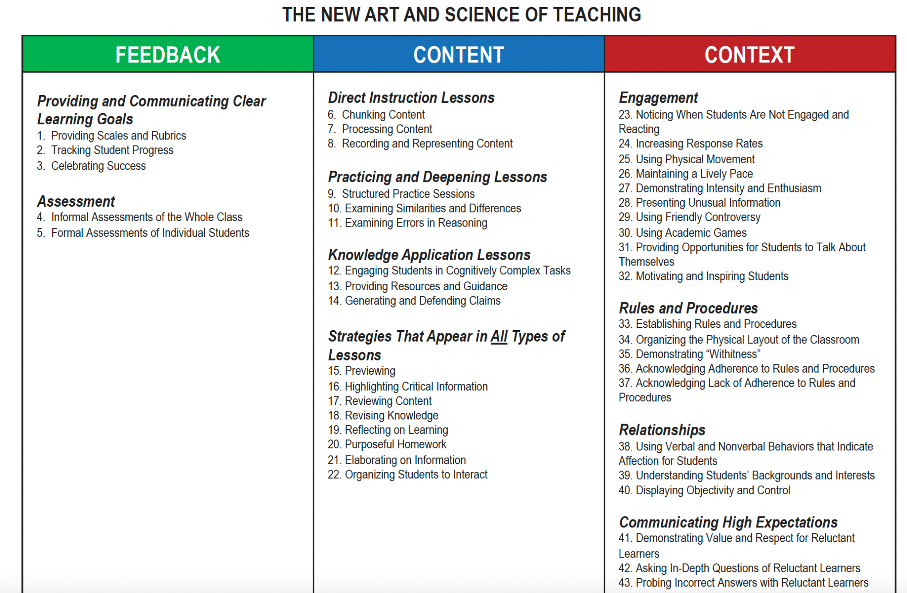
Instructional Model

Slide 18
Framing the Lesson
Notes:
Why do we need norms?
Because we all learn differently! This is your chance to share your learning needs.
Because we are human! We aren’t always on our best behavior and norms remind us we are in a group of learners
Because we don’t want to waste our time! We have so much to learn in one day, every minute counts!

Slide 19
Notes:
Mention that ratios and proportions are new, however, they do have experience with representing fractions from a model

Slide 20
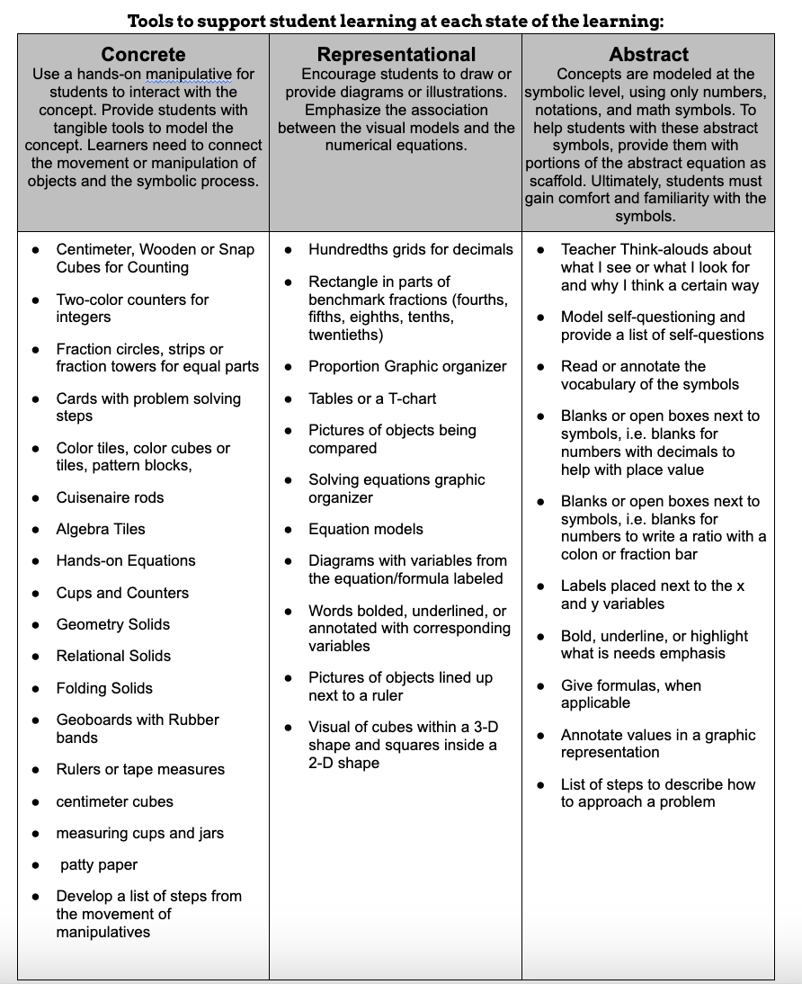
What else could be added to this list?

Slide 21
Success Criteria
Learning Intention
I know I am learning when…
I can create a concrete model of a given ratio.
I can connect concrete models of ratios to pictorial representations.
I can select a strategy to solve ratio problems.
I am learning how to solve problems involving ratios.
TEKS: 6.4C & 6.5A
Resources for the
6th grade Unit 3 training

Slide 22
Warmup
Directions: What fraction of the space is occupied by each color?
Think about how you can defend your answer.

Slide 23
Build with Tiles
The ratio of the number of red to blue tiles on the table is 2 to 3.
Build a ratio of 2:3 to represent red tiles to blue tiles.
Red | 2
Blue | 3

Slide 24
The ratio of the number of red to blue tiles on the table is 2 to 3.
Using your tiles, add another set of tiles with a ratio of 2 to 3
Complete the table, describing the number of red and blue tiles in your ratio.
Red | 2
Blue | 3
4
6

Slide 25
The ratio of the number of red to blue tiles on the table is 2 to 3.
Using your tiles, add another set of tiles using the ratio of 2 to 3
Complete the table, describing the number of red and blue tiles in your ratio.
Red | 2 | 4
Blue | 3 | 6
6
9
Notes:
Old question-Using your tiles, how many red tiles are there when there are 9 blue tiles?
What other patterns do you notice?

Slide 26
The ratio of the number of red to blue tiles on the table is 2 to 3.
Using your tiles, add another set of tiles using the ratio of 2 to 3
Complete the table, describing the number of red and blue tiles in your ratio.
Red | 2 | 4
Blue | 3 | 6

Slide 27
What patterns do you notice?
Notes:
What other patterns do you notice?
Ask these questions on slide 22

Slide 28
Build with Tiles
When you continue to build equivalent ratios, which ratio could you build?
Red to blue ratio of 12:20
or
Red to blue ratio of 10:15
I could build a red to blue ratio of ______ because_____.
Notes:
Either build or continue in the table to answer the questions

Slide 29
Build with Tiles
Using your tiles, how many blue tiles will we have if we have a total of 35 tiles?
Notes:
Show the various ways students solved

Slide 30
Build with Tiles
At a store, the ratio of the number of apples sold to the number of blueberry containers sold is 4:2.
Use a table to record the equivalent ratios you build.
Red
Blue

Slide 31
The number of apples sold to the number of blueberry containers sold is 4:2.
Which ratio could represent the number of apples sold to the number of blueberry containers sold in an order?
8:15 12:8 8:4 6:12
I could build a red to blue ratio of ____ because_____.

Slide 32
Record your process
Make a 4:2 ratio of red to blue.
Is a 4:8 ratio of red to blue an equivalent ratio you could make?
The ratio of 4 red and 2 blue _______ equal to 4 red and 8 blue because…
is/ is not
Red
Blue

Slide 33
Record your process
The ratio of dogs with red leash to the number of dogs with blue leash is 4:3.
Use the red and blue tiles to model the situation.
Red
Blue
Which ratio could represent the number of dogs with a red leash to the number of dogs with a blue leash? Why?
16:9 12:16 12:9 6:8

Slide 34
Closing
On your paper, respond to the question:
What patterns did you notice?
On a sticky note:
What questions do you still have?

Slide 35
Day 2 - Abstract
Using the ratio tables, students will represent rates and ratios in tables & graphs
and
give examples of ratios describing the same attribute (an equal ratio)

Slide 36
Future application
6.4D-The break down strategy in a ratio table or with a rate
Example: Hector paid $105 for 6 tickets to a football game. Each ticket cost the same amount.
What was the total cost of each ticket in dollars and cents?
➗2
➗3
➗3
➗2
or
$ | 105 | 52.5 | 17.5
tickets | 6 | 3 | 1
$ | 105 | 35 | 17.5
tickets | 6 | 2 | 1

Slide 37
Future application
6.4B and 6.5B build up/break down strategy a ratio table could use multiples of ½, 1, double, fives, tens, and tenths. Students will practice setting up ratios and using ratio tables. ex.
On Wednesday 72% of the customers who bought gas at a gas station made additional purchases. There were 250 customers who bought gas.
How many of these 250 customers made additional purchases?
In Texas, 3 armadillos ate 50 pounds of insects in one night. At this rate, how many pounds of insects could 18 armadillos eat in one night?
or
x2
x3
➗2
x5
armadillos | 3 | 6 | 18
insects | 50 | 100 | 300
part | 72 | 36 | 18
whole | 100 | 50 | 250

Slide 38
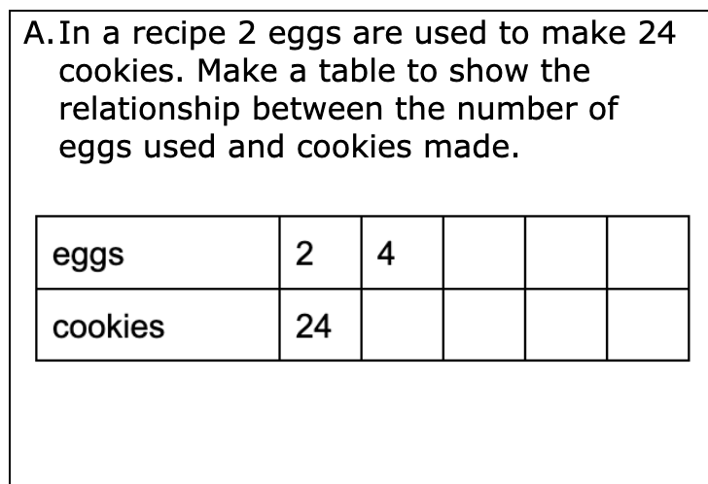
Notes:
This graphic organizer can be shared with the case manager to be part of the IEP
Tens frame

Slide 39
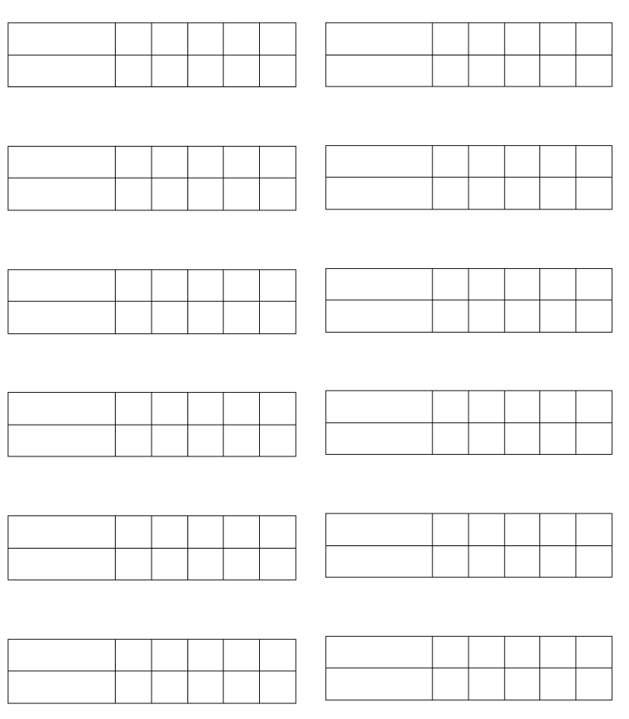
Graphic Organizer
Notes:
Extra copies available for students to use -https://docs.google.com/document/d/10SX3VY1cqpWYREU088KD1rWDq0B04BDS85rX4Z7mT3s/edit?usp=sharing

Slide 40
What impact do you think this lesson will have on student learning?

Slide 41
Lunch

Slide 42
Gifted Services
Reminders and Conversations

Slide 43
Gifted in Texas
As defined by the Texas Education Agency:
A gifted/talented student is a child or youth who performs at or shows the potential for performing at a remarkably high level of accomplishment when compared to others of the same age, experience, or environment and who exhibits high performance capability in an intellectual, creative, or artistic area; possesses an unusual capacity for leadership; or excels in a specific academic field.
* School districts across the state have the flexibility to service Gifted and Talented students based on district resources and needs.

Slide 44
3 Words:
What three words come to mind when you describe a student that is identified as GT?

Slide 45
Gifted Learners:
Myths & Misconceptions
Gifted learners don’t need help; they’ll do fine on their own.
That student can't be gifted; they are receiving poor grades.
High Academic Growth = High Social Growth
Gifted children are good at everything they do.
Gifted learners are always motivated to learn new things.

Slide 46
Common Characteristics
Of GT Students
High intellectual ability
Creative problem solvers
Curious
Emotional depth & sensitivities (intensities)
Can adapt to new situations and makes abstract connections to content
Highly motivated when working on tasks of value.

Slide 47
#WhyGT?
GT is about services that take place in the classroom.
How do we modify what is happening in the classroom for GT students so that the curriculum meets their needs?

Slide 48
Always, Sometimes, Never
What are some things you always expect to see in a GT math classroom? Sometimes? Never?

Slide 49
Gallery Walk
What patterns do you see?

Slide 50
Honors & GT Courses
Keep in mind that the activities and enrichments we provide don’t have to be kept specifically for our GT students–we just want to provide the opportunity for our students who master the content to have something engaging to do that deepens their knowledge.

Slide 51
GT Professional Learning - Reminders
Per the Texas State Plan - 5.1 A minimum of thirty (30) clock hours of professional learning that includes nature and needs of gifted/talented students, identification and assessment of gifted/ talented students, and curriculum and instruction for gifted/talented students is required for teachers who provide instruction and services that are a part of the district’s defined gifted/talented services. (19 TAC §89.2(1)).
This is a one-time training.
The 30 hours of GT foundational training must be documented in a teacher’s Eduphoria Strive Portfolio for TEA Compliance.

Slide 52
GT Professional Learning - Region 20
NEISD is part of the Region 20 GT CO-OP and courses are free when you register for session with your NEISD email.
Region 20 has asynchronous, in-person, and Zoom options available.
Region 20 Connect and Region 20 Asynchronous Courses
For Region 20 courses, teachers MUST upload certificates to their Eduphoria Strive Portfolio upon completion to document hours for NEISD.
New sessions are added regularly to the catalog.
NEISD Region 20 GT Flyer
GT professional learning opportunities are also posted in weekly teams updates.

Slide 53
Scaffolding to meet the diverse needs of all learners
SPED Specialist Presentation

Slide 54
EMERGENT BILINGUAL
STUDENTS’
SUPPORT
Secondary Bilingual/ESL Department
Notes:
PRESENTATION

Slide 55
Mix and Mingle
When the music stops, pair up with someone nearby.
What was the Most Important Point (the thing that resonated the most for you) that you learned this morning?

Slide 56
When in the lesson did you see each component of CRA?
Notes:
What other manipulatives could replace the tiles?

Slide 57
Let’s Revisit the DEUA
Review the questions again, find at least two questions and solve them differently than you did this morning.
How can these strategies be used in scaffolding, deepening, intervention, or extension?

Slide 58
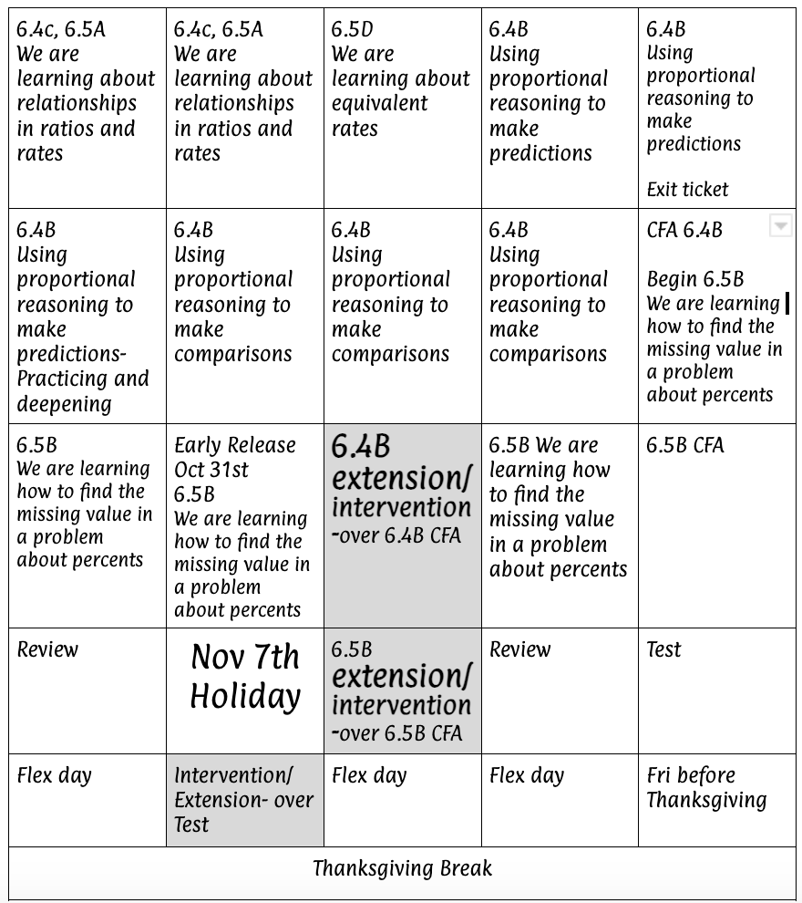
Intervention & Extension

Slide 59
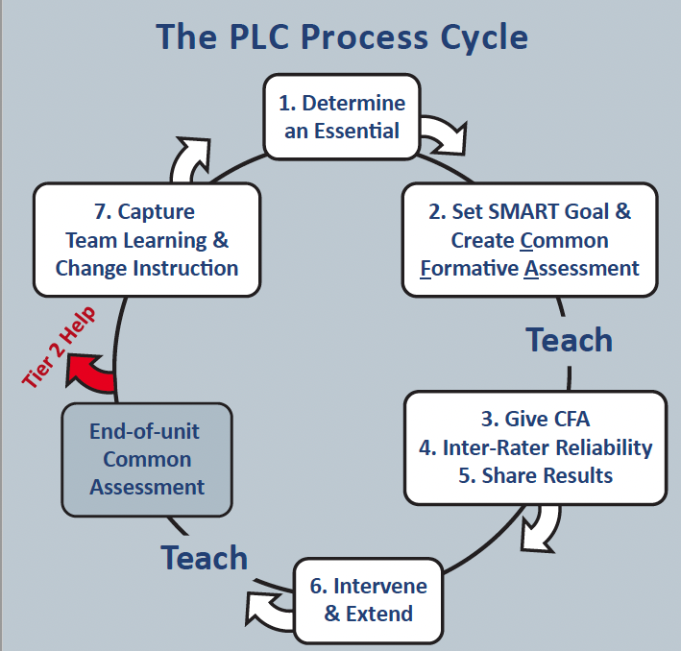

Slide 60
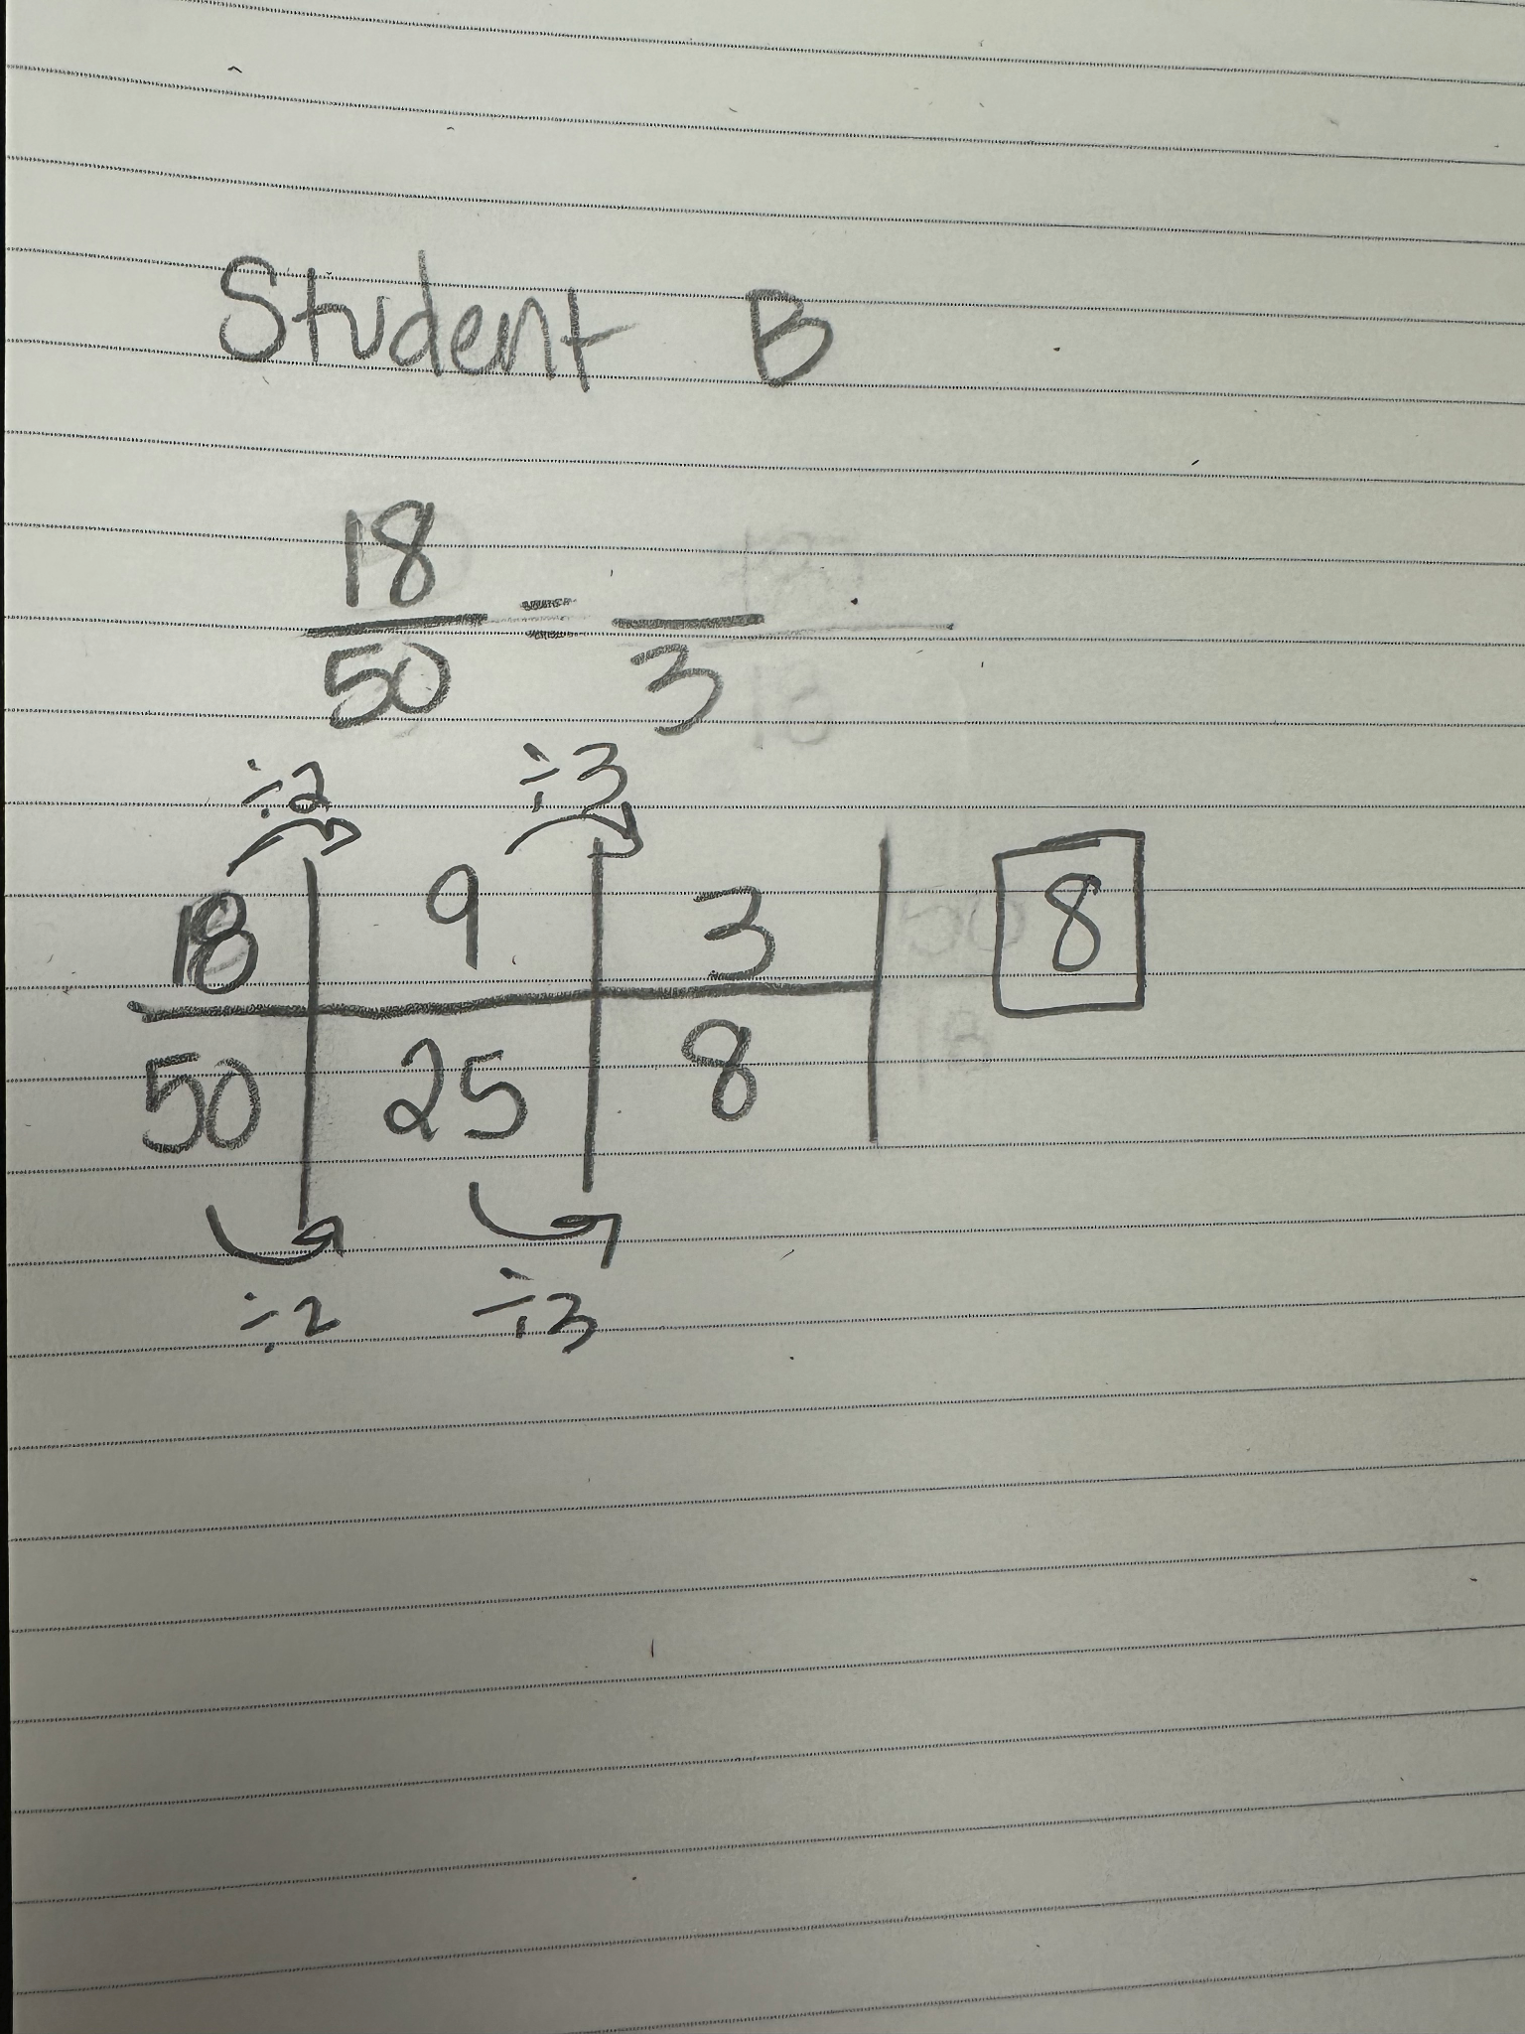
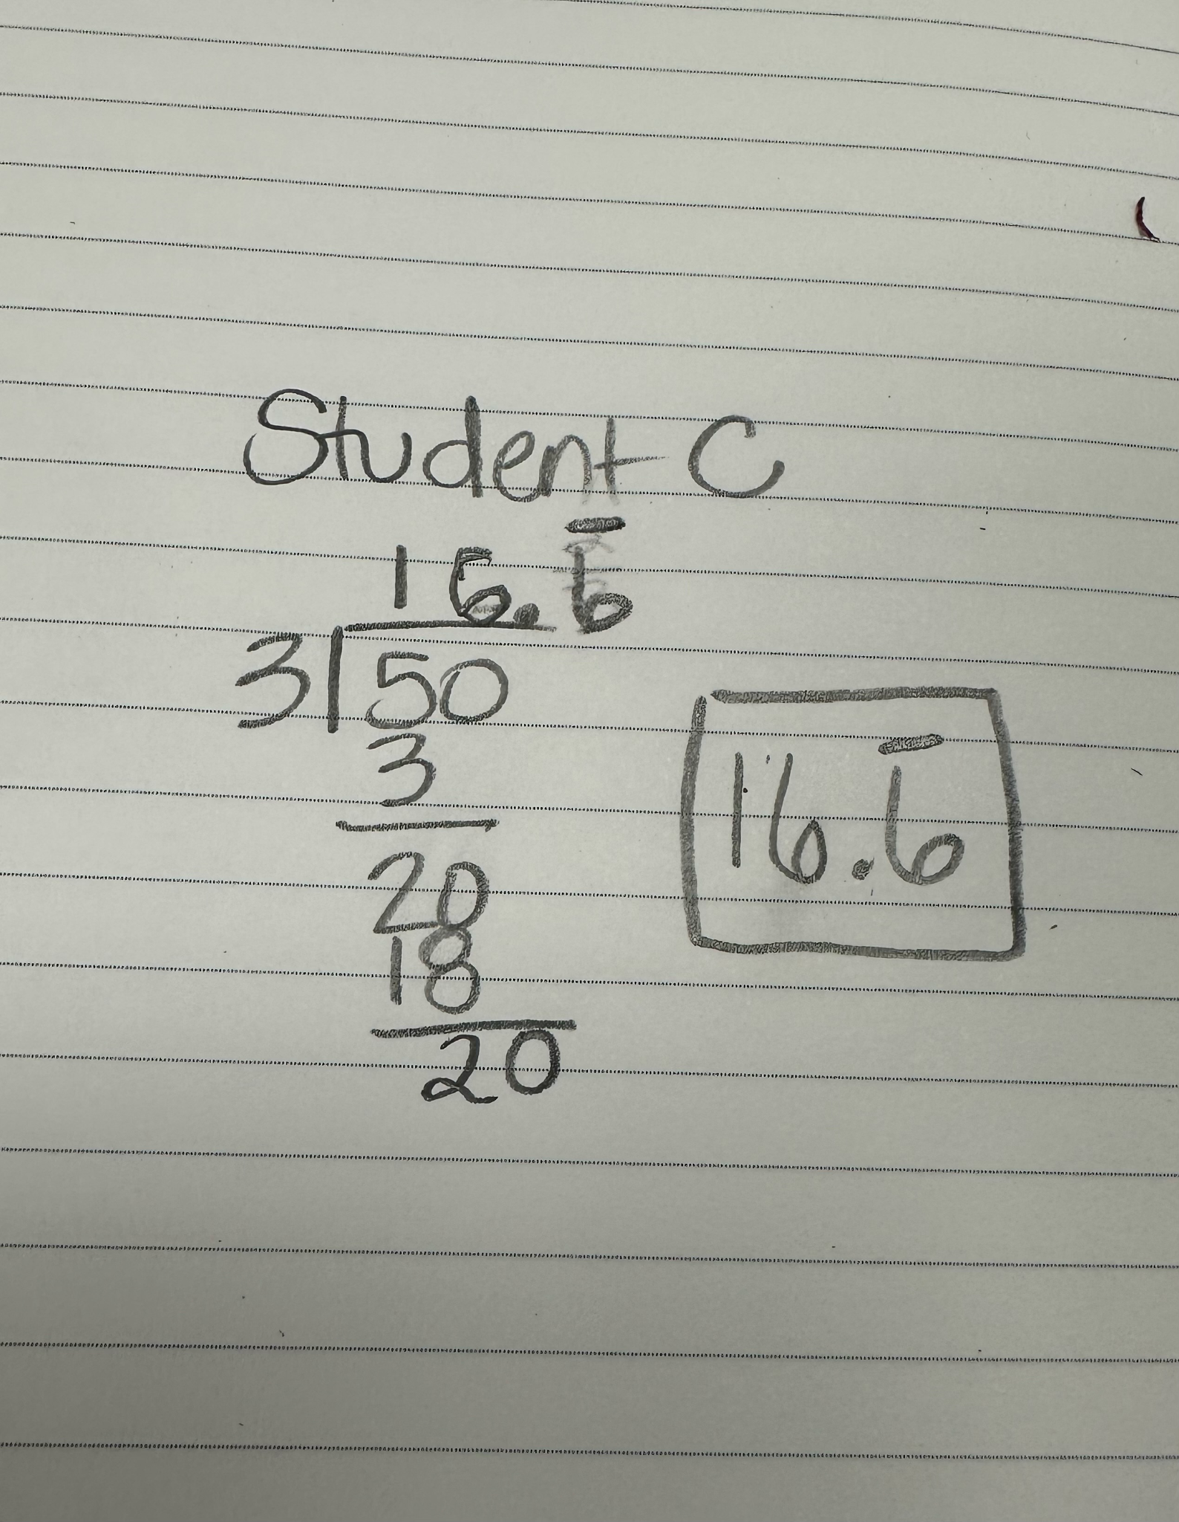
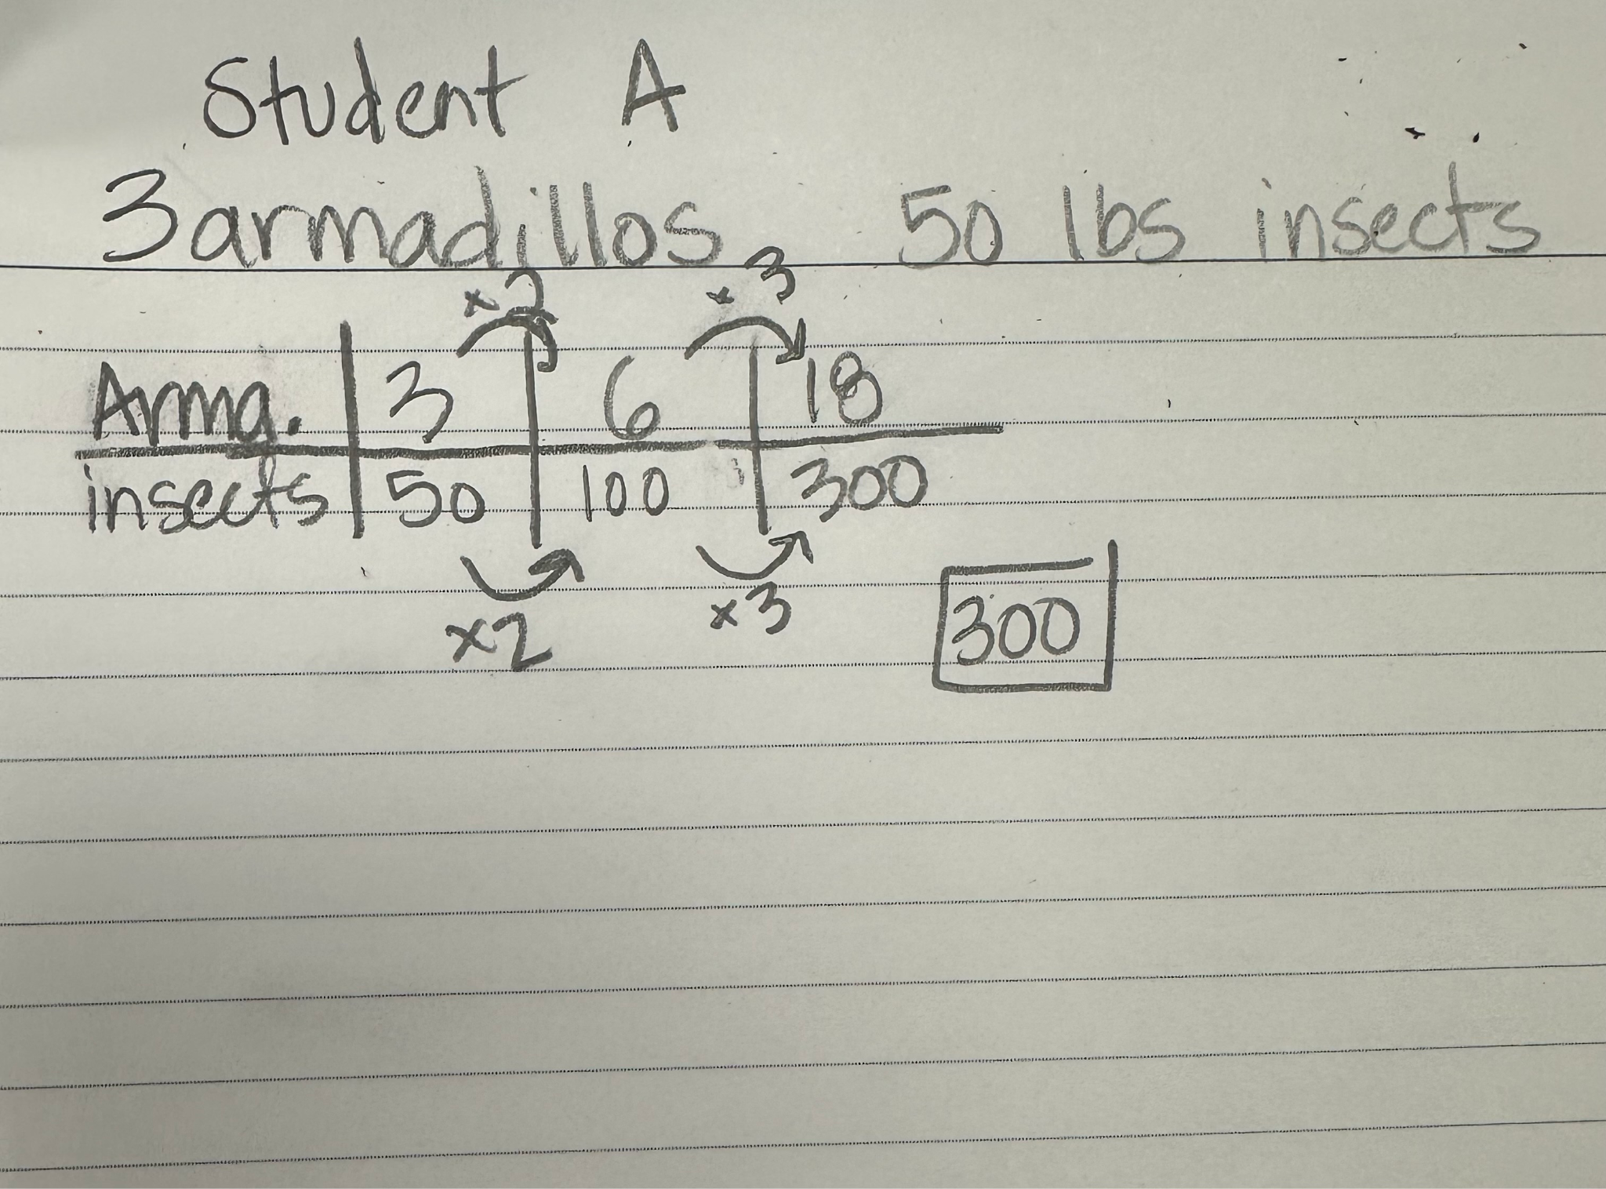
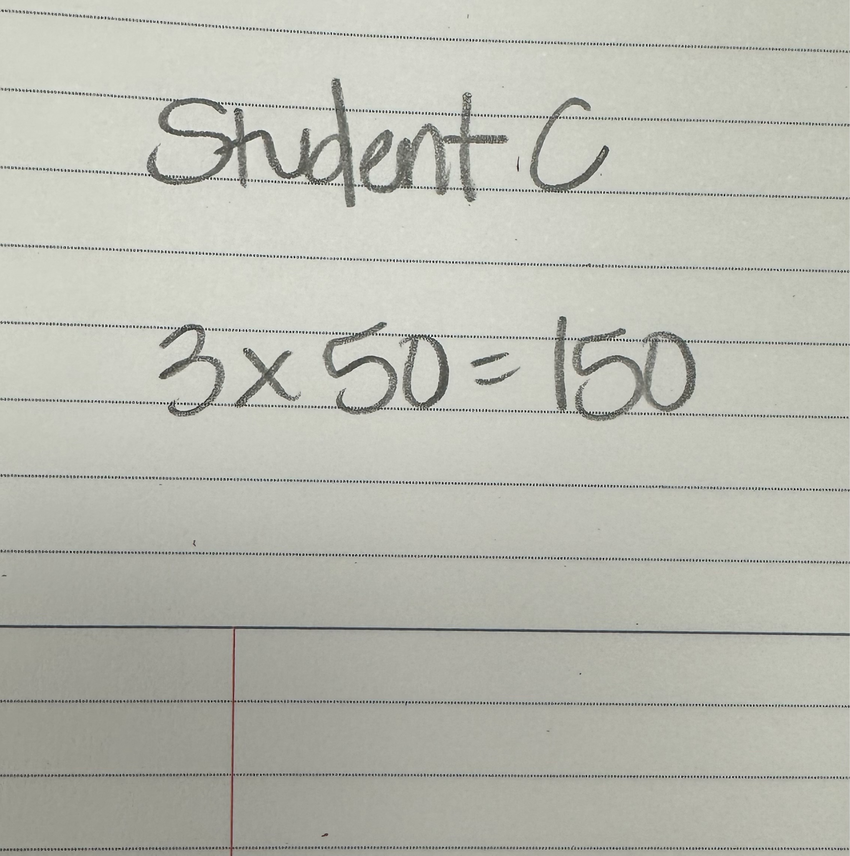
Student Responses

Slide 61
Student Responses

Slide 62
Student Responses

Slide 63
Student Responses

Slide 64
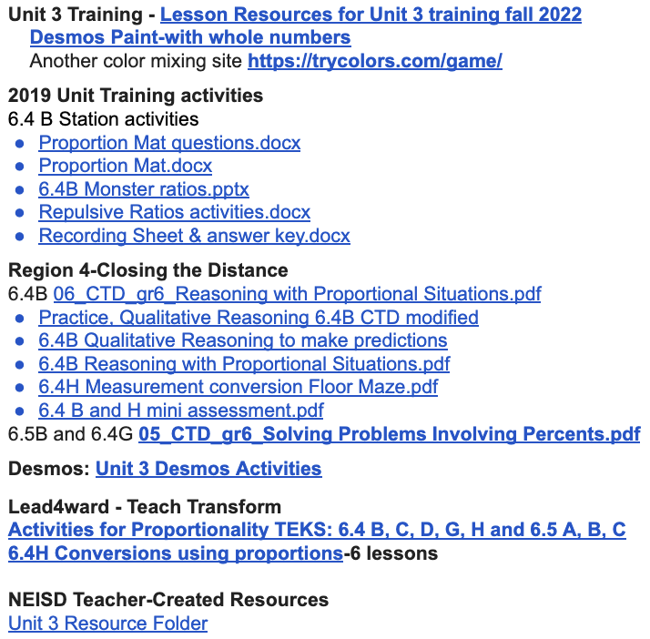
Framing the Lesson
Extension:
Using the patterns, there are three groups:
Group A: Blue - Extension
Group B: Pink - Practice
Group C: Green - Small Group
Procedures & Expectations:
Student will enter the room and go directly to their groups.
All students will engage in a warmup and an exit ticket.
The Pink group will have a self-check station, if they finish early they can work on the extension.
Practice:
Notes:
Two groups needing support
Small Group 1: https://drive.google.com/file/d/1o-8PT3hkicUBI-1h5lPYz5rY4Al96eox/view?usp=drive_link
Small Group 2: https://docs.google.com/document/d/1-tNnDHveCM3QrNwyaJ5Ofmj_rMMNnslivsbtcI675EU/edit
Extension: https://drive.google.com/file/d/0B4z_e2W1_Eb7bHk5ZHp0d0Z2ck0/view?resourcekey=0-0pS1QdXZ1fXEgLwejms2ew (original)
Extension: https://drive.google.com/file/d/1wCjkiNtwksntjktbcNQla-C-OhltCptj/view?usp=drive_link (updated with notes)

Slide 65
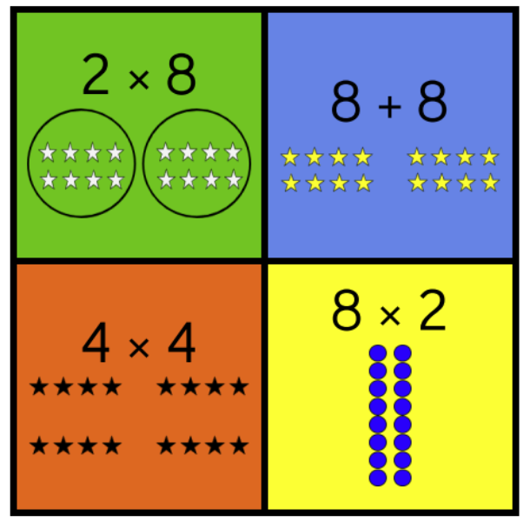
Today’s Learning
WARMUP:
Which one doesn’t belong?
Learning Intention: We are learning about solving word problems involving ratios.
Success Criteria: I know I am learning when I can
Identify the ratios needed to solve
Accurately solve to answer the question
Procedures & Expectations:
Student will enter the room and go directly to their groups.
All students will engage in a warmup and an exit ticket.
The Pink group will have a self-check station, if you finish early you can work on the Dog Years Dilemma activity.

Slide 66
Sit in your table group and begin working on the assignment.
Blue
Table groups
Rebecca
Angela
Leah
Sheila
Kevin
Jenn
Pink
WARMUP:
Which one doesn’t belong?
Bibianna
George
Noah
Alicia
Kellye
Green
Amber
Alli
Abigail
Ricky
Mark
Meaghan
Nia
Flor
Jonathan

Slide 67
Exit Ticket
What are you most proud of from class today?
What was most challenging about class today?

Slide 68
Debrief
What components would you keep?
What components would you change for your classroom?

Slide 70
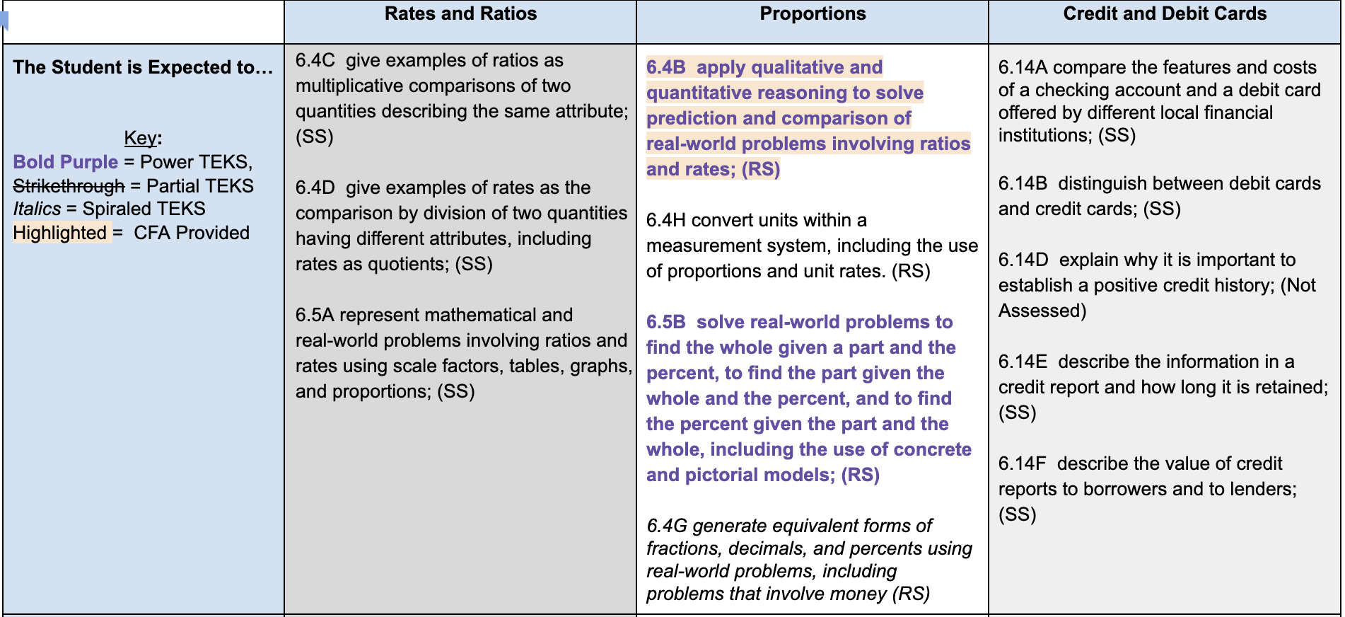
Gallery Walk
Get in groups of 3-4.
For your assigned chunk of learning:
What opportunities are there for manipulatives?
What are scaffolding strategies that could be used?
What are deepening strategies that could be used?
Notes:
Get hands on kits
https://goblin.tools/

Slide 71
As you rotate:
Add any other ideas to the poster.
Add questions you have to a sticky note.
Add a star next to any ideas you want to use and record them on your handout.

Slide 72
Learning Intention
Success Criteria
I am learning about research-based strategies that meet the needs of all learners.
I know I am learning when…
I can use the District End of Unit Assessment to compare expectations for learning.
I can describe scaffolding and deepening strategies.
I can plan a direct teach lesson using NASOT elements.
I can select an extension and an intervention strategy to implement in my classroom.

Slide 73
Reflection
What information will you take back to your team?
What is one idea from today’s learning that you want to implement in your classroom?
What do you need to be successful in this unit?

